Slide 1
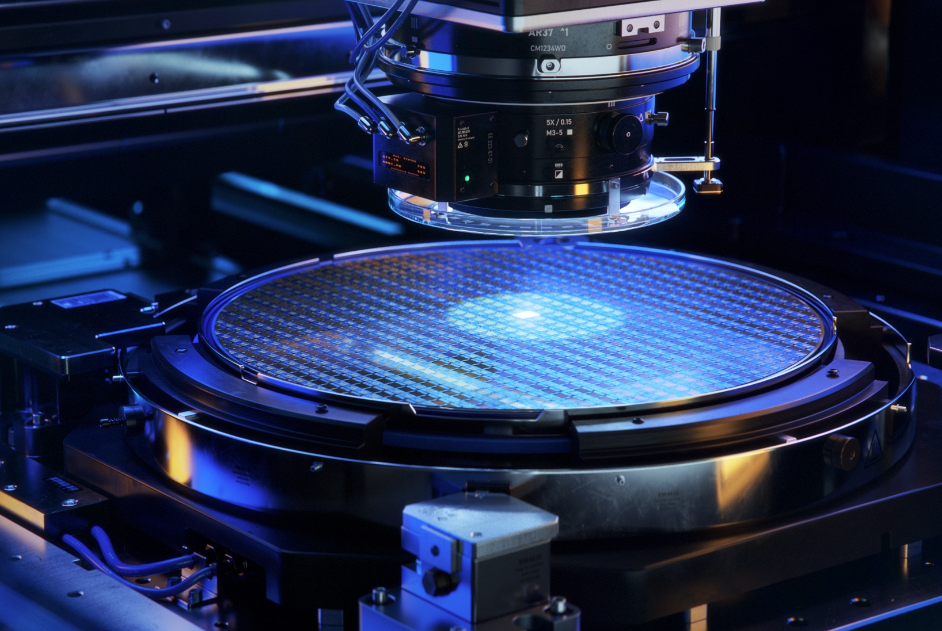
29 July 2026
AI-driven Autonomous Deposition Lab
Project proposal

Slide 2
AI AUTONOMOUS OPERATION PROPOSAL · PROBLEM DEFINITION
Problem definition
Process quality on MBE and PVD still rests on the operator's judgement in the moment
01
Latency
02
Not reproducible
03
Does not scale
A human reacts to an anomaly in minutes. Changes during growth happen in seconds
The same recipe spreads across shift. Procedure judgement different across operators.
Experienced engineers cant be increased linearly at the same rate
Autonomous operation + closed feedback loop
turning engineering intuition into an quantifiable, reusable software asset
OBJECTIVE
AUTONOMOUS AGENT
Sensor
State prediction
Decision
Verification
Bounded
action
Full audit
log
Learn &
refit

Slide 3
AI AUTONOMOUS OPERATION PROPOSAL · LANDSCAPE
Landscape: current examples
MBE agentic operation
(IVWorks)
(Jun 2025)
Korean GaN epiwafer foundry. DOMM Agent drives the MBE control PC: scheduled load–grow–unload runs execute unattended on nights/holidays with real-time pass/fail prediction. no detail/yield/dispersion figures published
1
AI-Driven Epitaxy
(Paul-Drude-Institute)
(Jun 2026)
UnicornOne: vendor-agnostic LabOS unifying hardware, time-resolved RHEED and workflows. Real + synthetic RHEED simulation data trained hybrid multi-model AI for GaN growth. Time savings were translating into saving ~€55k/yr/system
2
Self-driving PVD lab
(University of Chicago)
(2025)
Autonomous PVD lab using robotics, in-situ optical spectroscopy, and Gaussian Process Regression ML. Uses a initial calibration layer to account for hidden chamber/substrate variations, optimizing silver film deposition to target optical specs in ~2.3 attempts.(vs 3.6 ablated)
3
Run-to-run process control & virtual metrology
(Spotfire USA)
(2026)
Simulated run-to-run Advanced Process Control and Virtual Metrology for sputter deposition on synthetic fab data. Used linear target models + EWMA offsets to continuously adjust deposition time, counteracting target-erosion drift and lifting process quality (Process Capability Index from <1.4 to >2.0)
4

Slide 4
AI AUTONOMOUS OPERATION PROPOSAL · TARGET WORKFLOW
Target workflow
Data model
Database of past recipes outcome pairs; calibrated forward model + inverse solver for MBE and PVD for recipe optimization
Monitor
+ Control
RUN-TO-RUN
optimized recipe
LOCAL LLM Orchestrator
Output
data
Equipment
Process control + state monitoring; MBE in-situ control via RHEED pipeline; PVD in-situ per available sensors
in-run loop
IN-SITU
Reasoning + Control
output wafer
EX-SITU
Measurement
All output quality assessments (thickness, uniformity, sheet resistance, stress .etc)
Infer results

Slide 5
AI AUTONOMOUS OPERATION PROPOSAL · AUTONOMY ROADMAP
Autonomy roadmap and engineering specification
LEVEL
SCOPE
PASS CONDITIONS
L1
full data capture before, during and after runs
all signals captured with time synchronization with acceptable latency
specification and data format readable and validated
Acquisition
L2
Read-only AI decision making with reasoning
Model calibration against our own tool data
decisions agrees with expert judgement consistently
Controls clear all fault-injection tests in simulation
Decision
L3
Supervised AI controlled operation
Machine controls all green and tested
write-back latency verified against fast-loop needs
operation stable over a sustained period & failure fallback drills passed
Supervised
L4
Continuous autonomous operation
Zero human intervention required across full execution cycles
Yield/quality metrics equal or exceed human expert baselines
Autonomous

Slide 6
AI AUTONOMOUS OPERATION PROPOSAL · EXISTING FOUNDATION
Current foundation
01
02
03
DATA MODEL
SENSING AND CONTROL
PHYSICAL SIMULATION
Recipe-Inverse Generator (RIG)
RHEED Analysis Pipeline
MBE Simulation
Forward model from recipe to result + inverse solver that back-calculates candidate recipes to meet requirements with uncertainty band and invalidation.
CNN + ViT computer-vision pipeline for in-situ image analysis and monitoring
+ LLM based control system interprets and suggests/executes actions.
A physics-based simulation model of the MBE chamber: flux geometry, surface kinetics, thermal model and a estimated RHEED output display.
CURRENT
CURRENT
CURRENT
Tested and validated on Empa’s High Impulse magnetron-sputtering (PVD) dataset. Able to predict input from desired output
Tested on TiO2 RHEED data. Able to identify, analyze and suggest actions based on RHEED livestream
Underlying physics built and calibrated based on literature values
NEXT
NEXT
NEXT
Validation on our own tool & data.
Validation on GaN RHEED data
Calibration against real tool data.

